Slide 1

Introduction to Robotics
CSE 461
Lecture 3 : Chapter 1(Introduction to robotics: basics)
Md Toki Tahmid
Lecturer, Dept. of Computer Science and Engineering
Brac University

Slide 2
Previous Class
Primitives
Paradigms

Slide 3
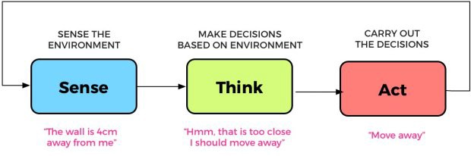
Recall

Slide 4
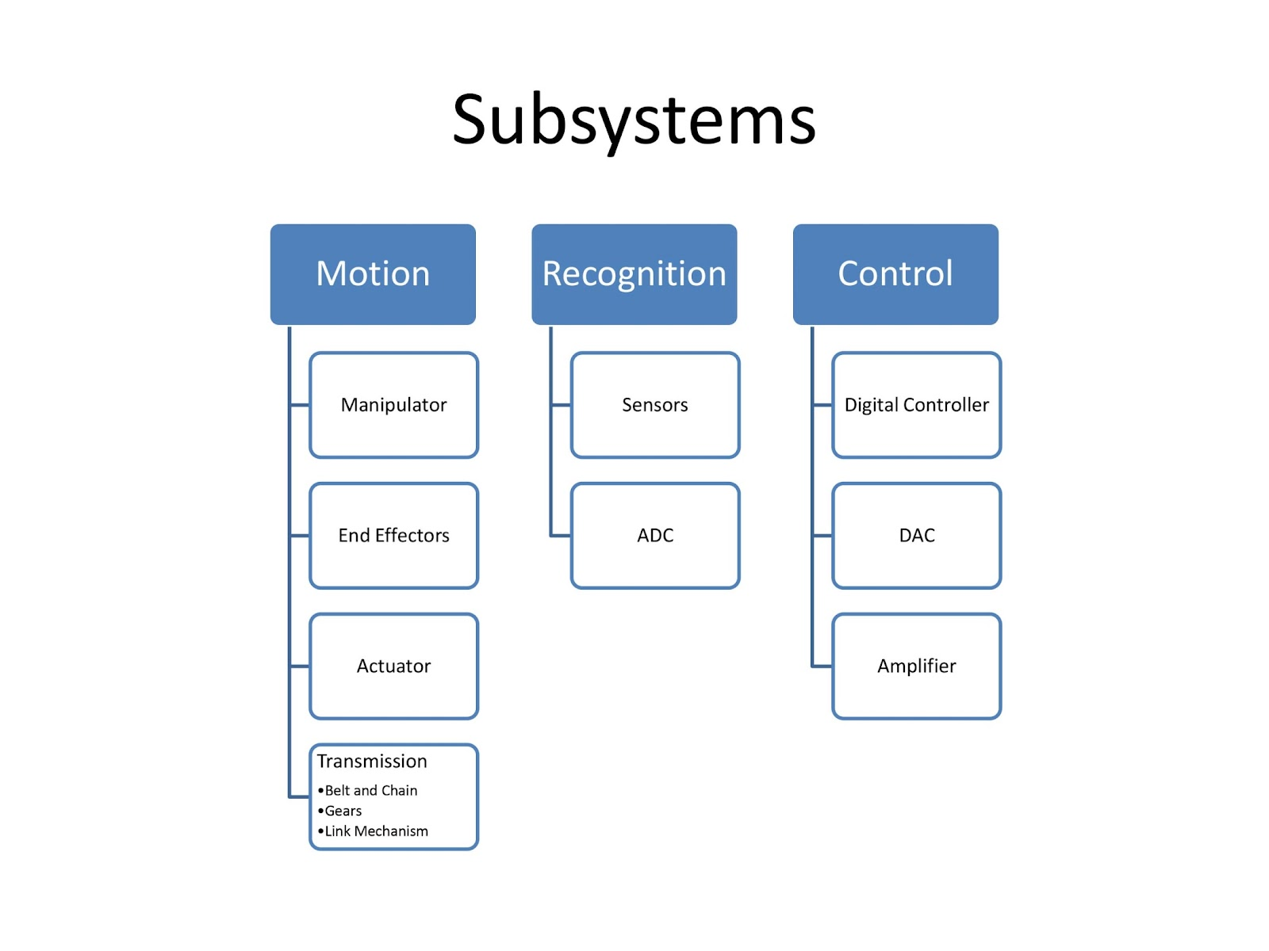

Slide 5
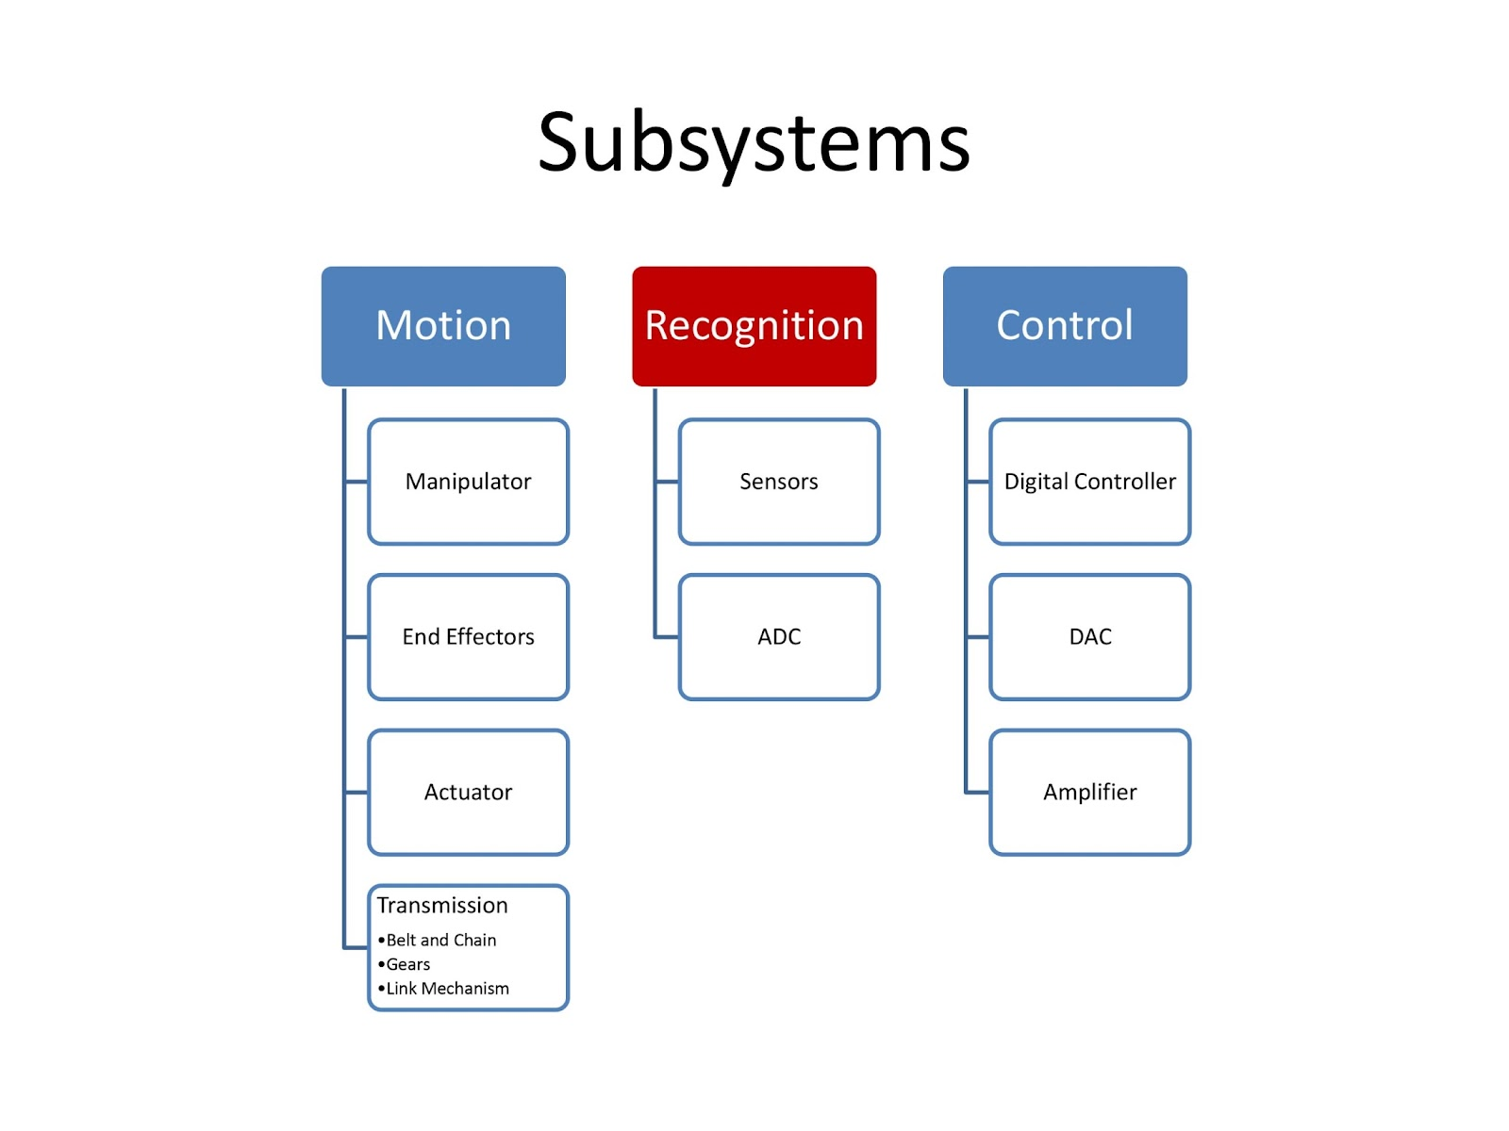

Slide 6
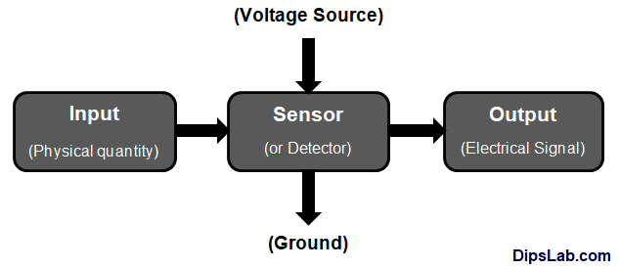
Sensor
A sensor is a device that detects or measures physical, chemical, or biological properties of the environment or a system and converts them into a signal that can be processed or analyzed.

Slide 7
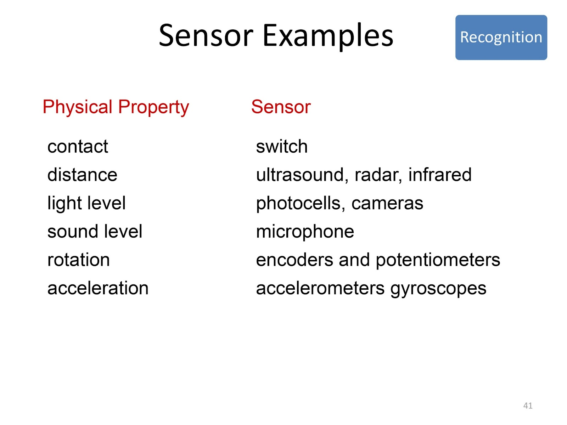

Slide 8
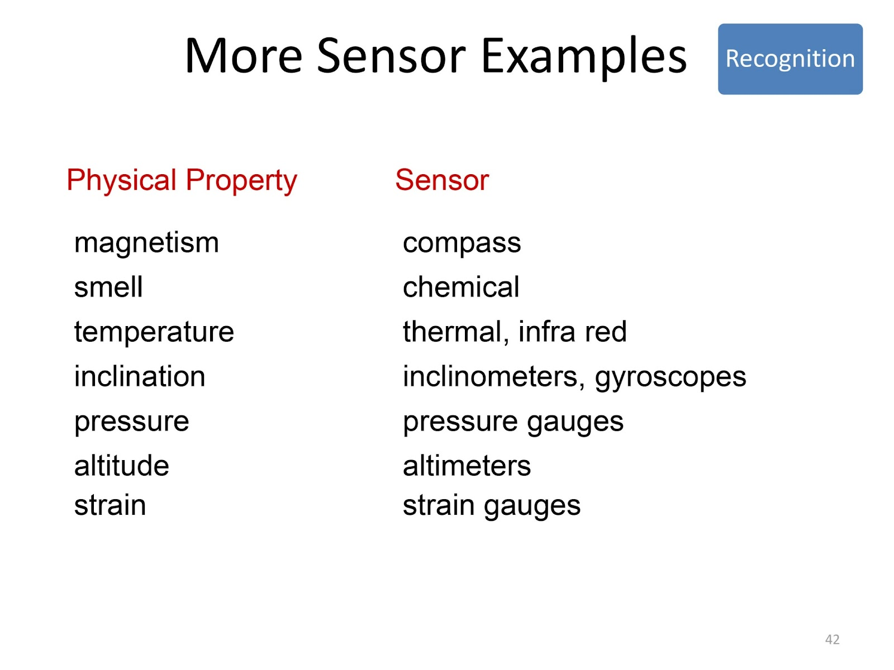

Slide 9
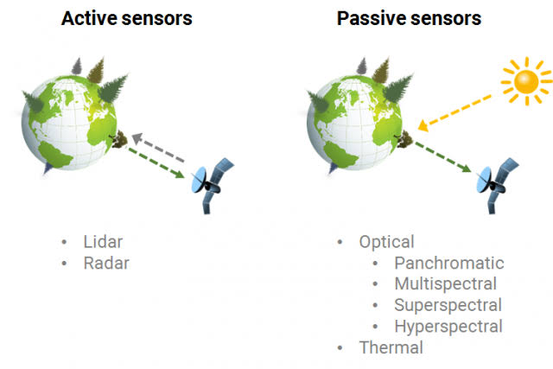

Slide 10
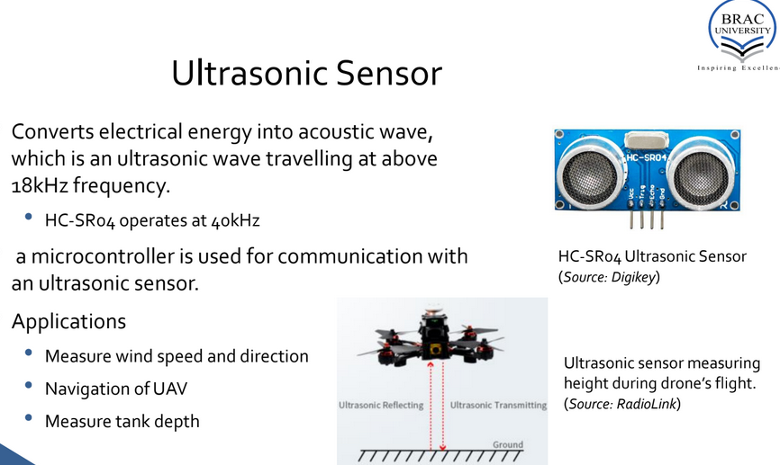

Slide 11
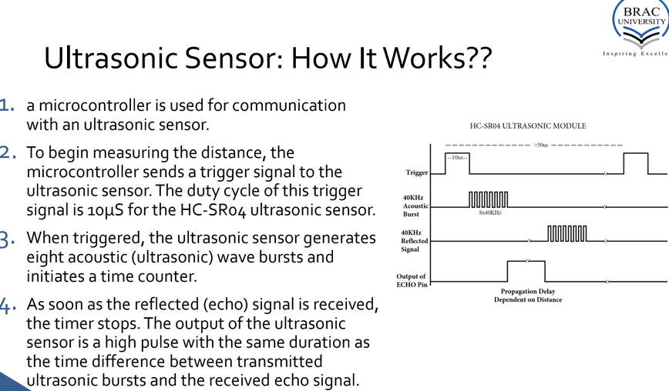

Slide 12
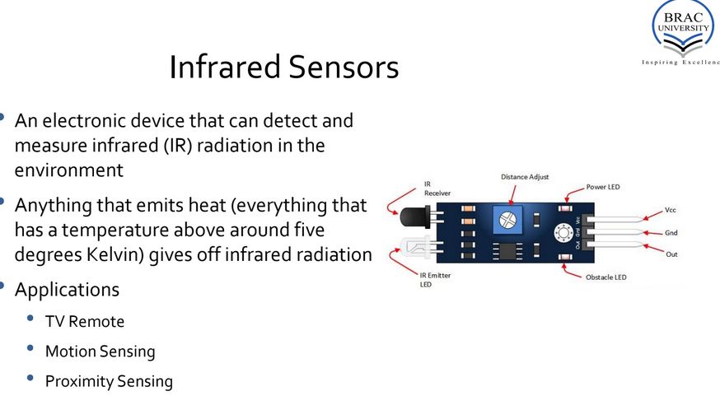

Slide 13
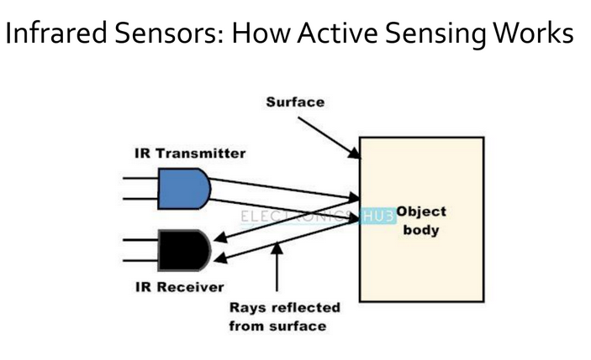

Slide 14
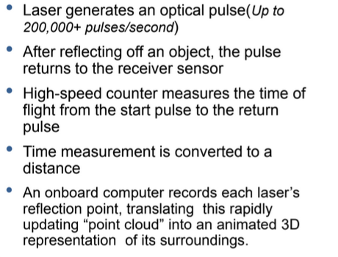
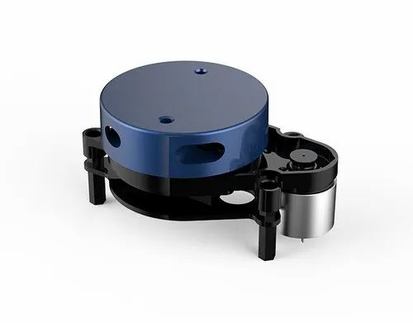
Lidar

Slide 15
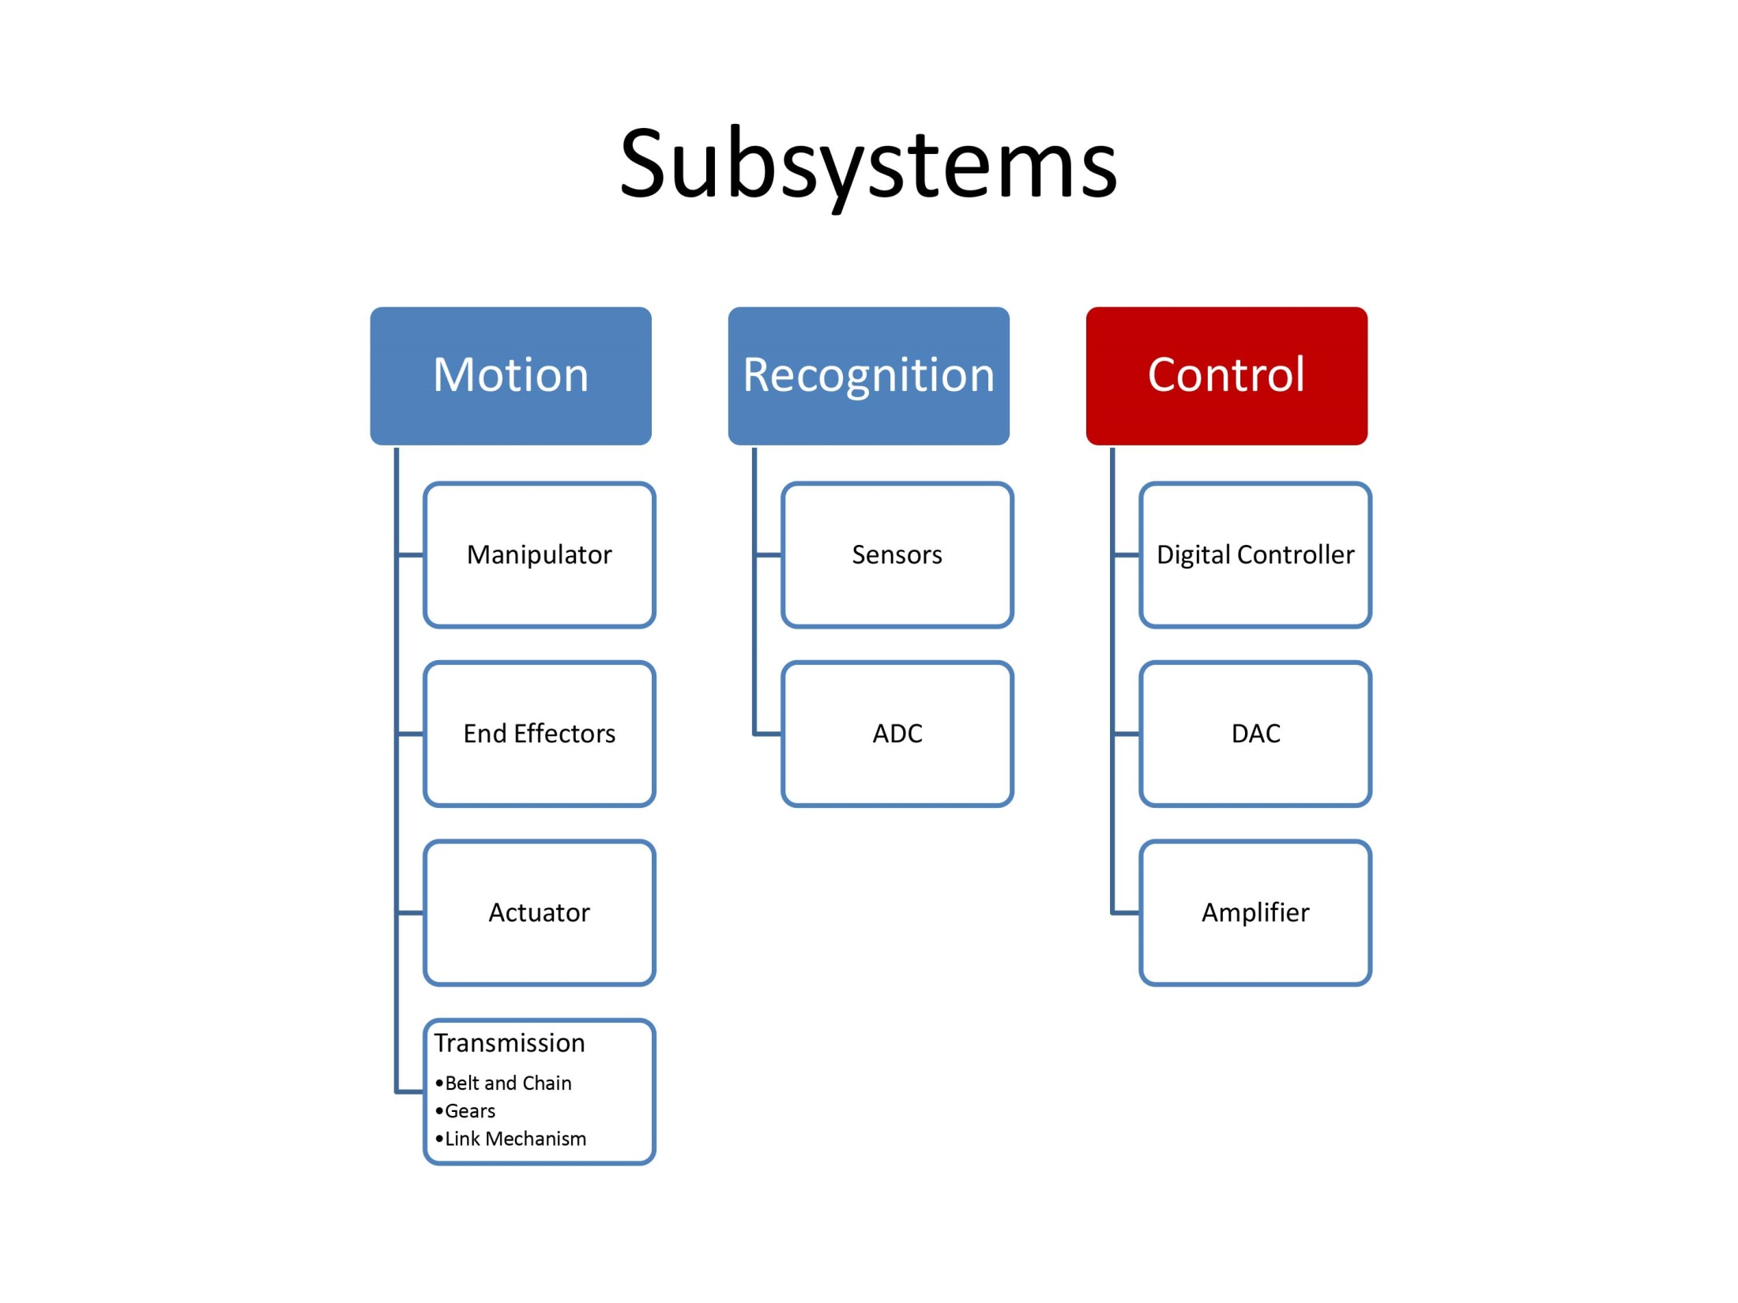

Slide 16
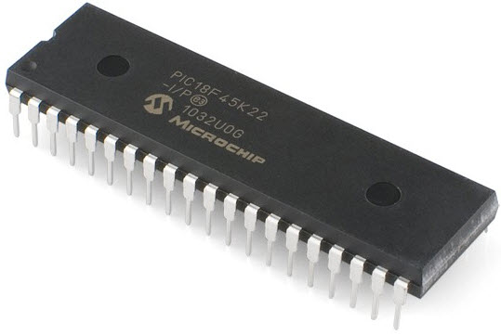
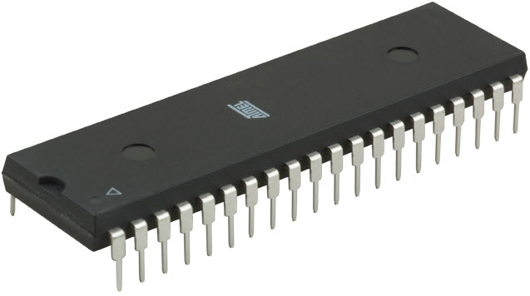
Microcontrollers
A microcontroller is a small, integrated circuit that contains a processor, memory, and input/output peripherals.

Slide 17
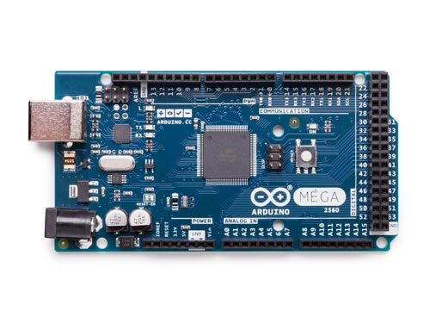

Arduino

Slide 18
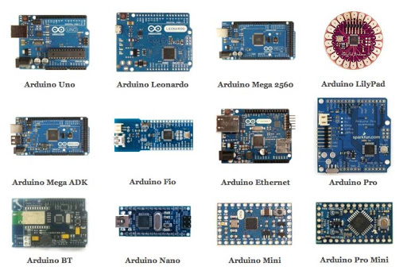
Arduino

Slide 19
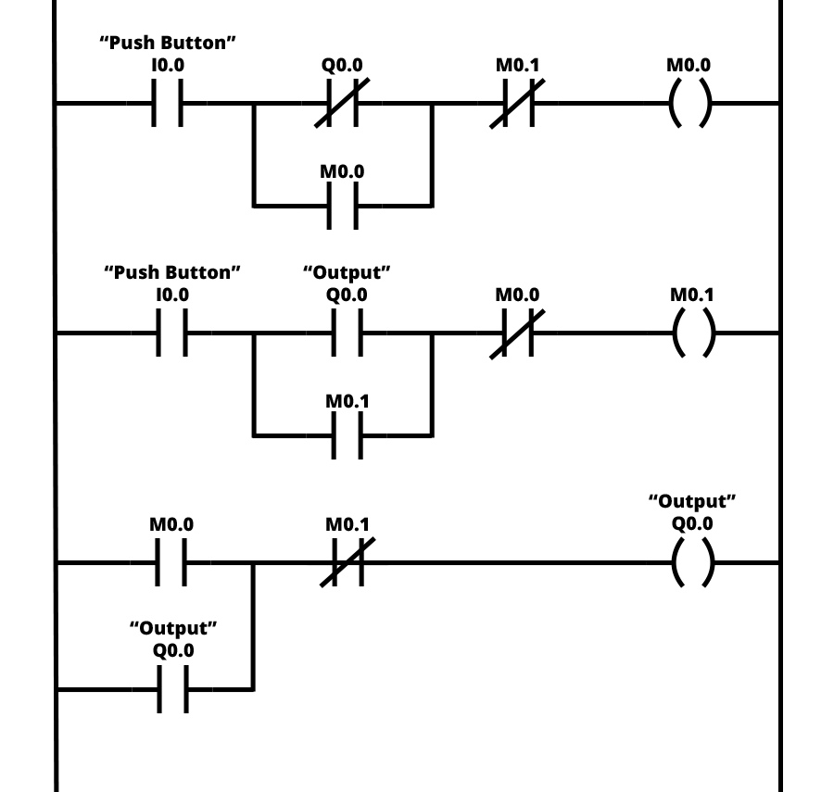
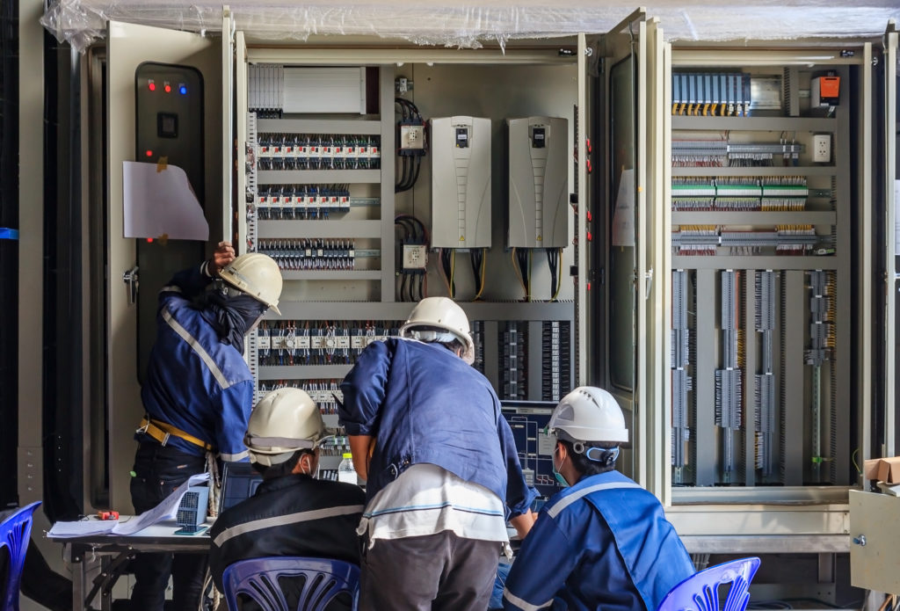
Programmable Logic Controller (PLC)

Slide 20
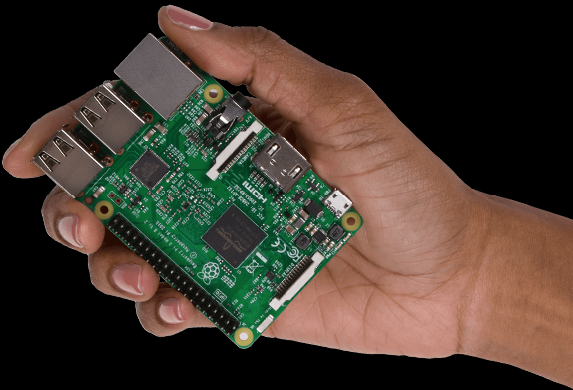
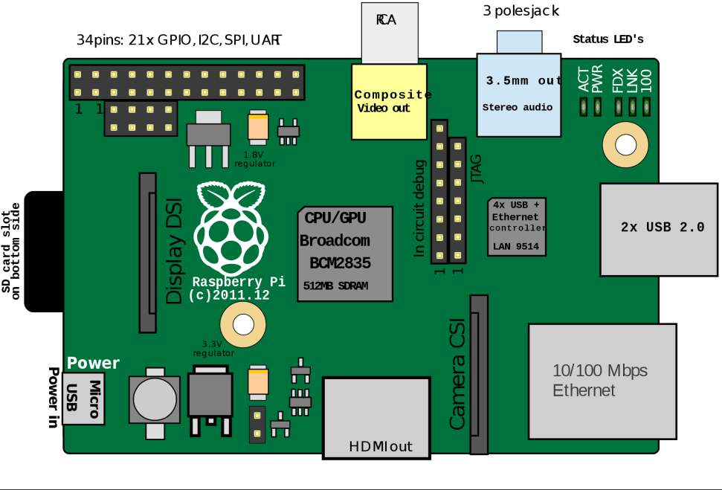
Single board Computer

Slide 21
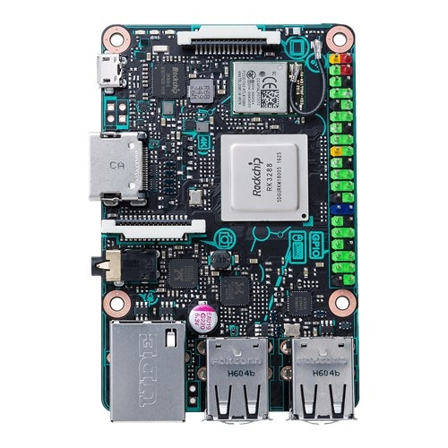
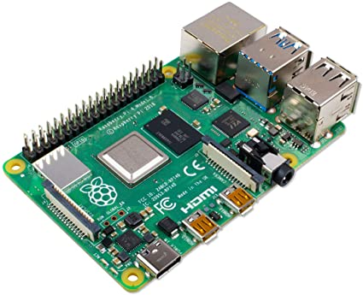
Raspberry PI 4, Tinkerboard

Slide 22
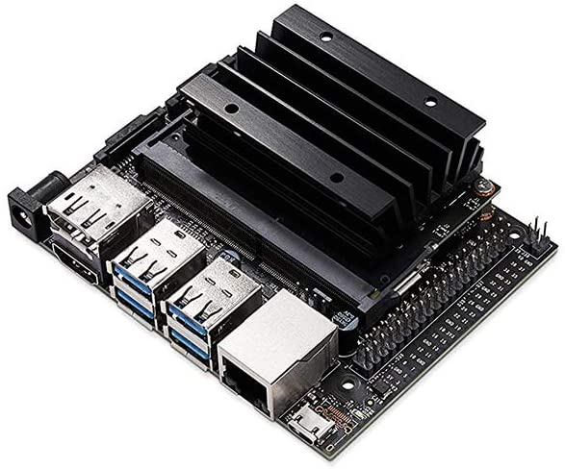
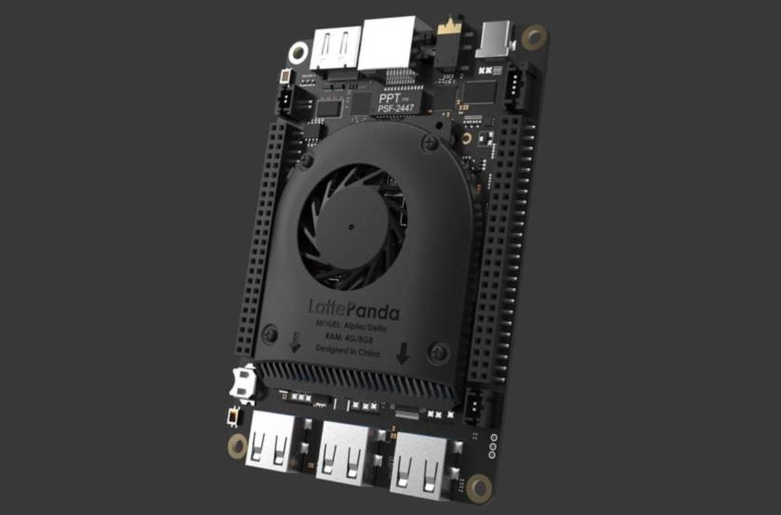
Little Panda and Jetson nano

Slide 23
Next Class
Subsystem (Motion)

Slide 24
Thank You

